Slide 1

From neural circuits to behaviour

Slide 2
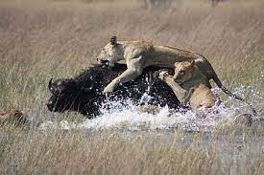
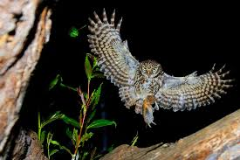
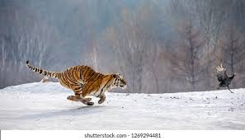
Animals hunt to capture prey
Can we identify the neural circuits that control this behaviour?

Slide 3
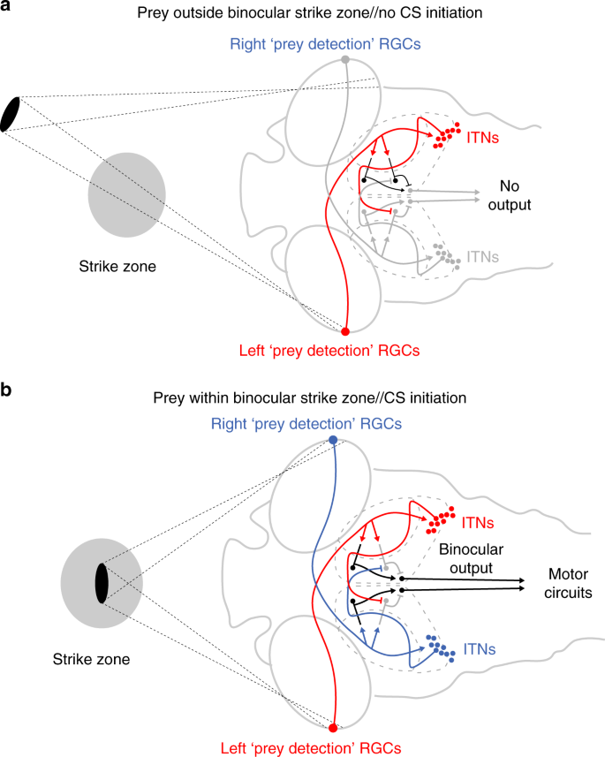

Command neurons can initiate entire behavioural programmes
Example: frogs catching prey with tongue

Slide 4
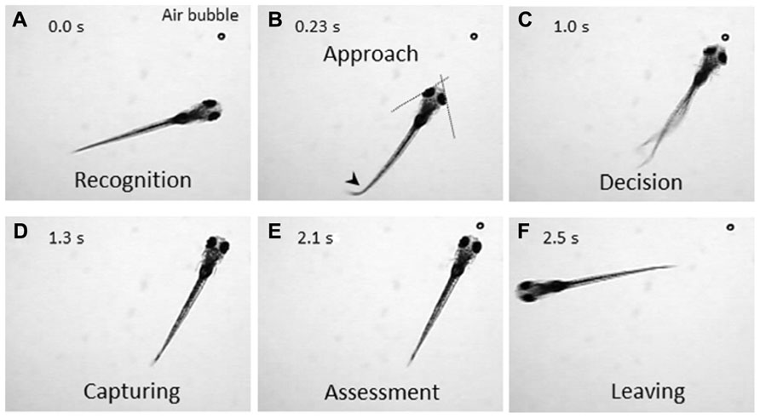
Prey capture in zebrafish
From 5 days onwards larval zebrafish hunt prey
such as small paramecia placed in a Petri dish
They use a stereotyped and graded behaviour
to do this:
Convergence of eyes
A sharp “J-turn” to move turn the body without
movement forward
A quick “capture swim” following by eating prey

Slide 5
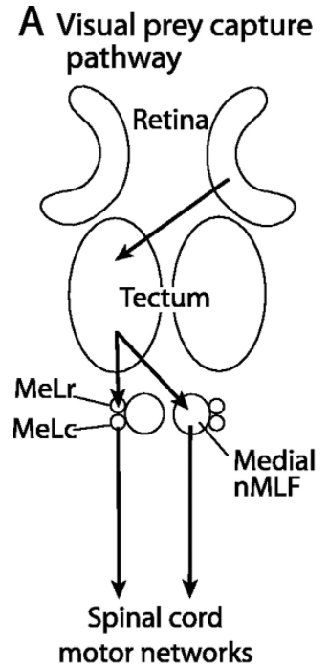
Prey capture in zebrafish
Prey capture reduced in dark
Processing in optic tectum is necessary

Slide 6
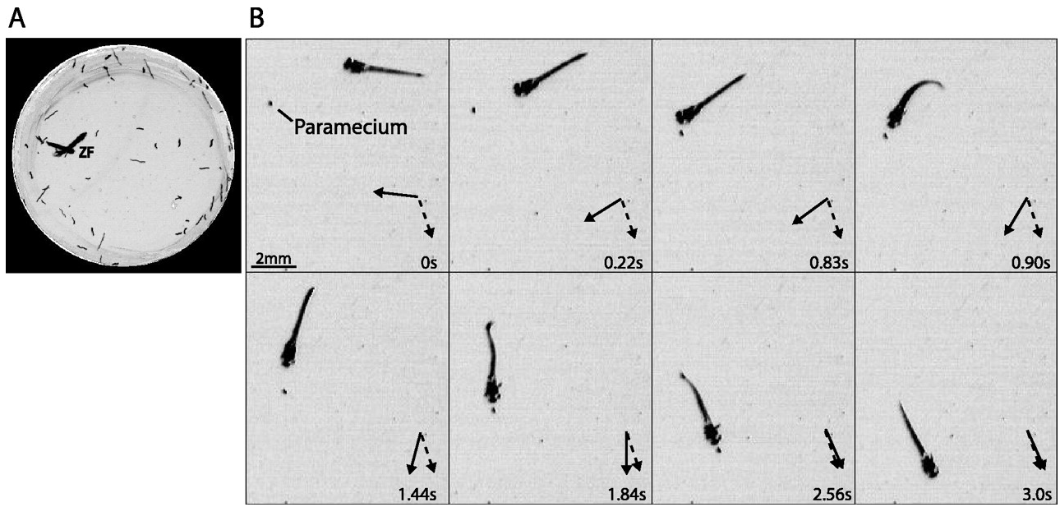
Prey capture in a Petri dish
Film free swimming larvae in a dish and count number of paramecium eaten over time
Gahtan et al., 2005

Slide 7
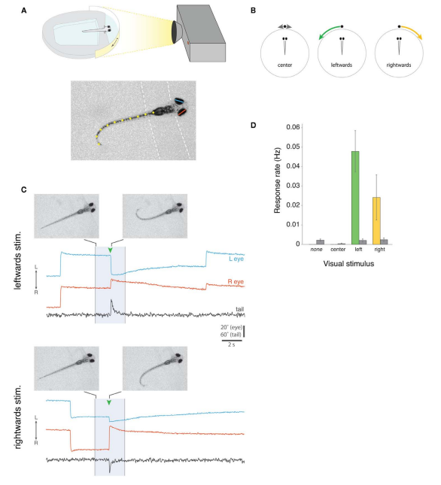
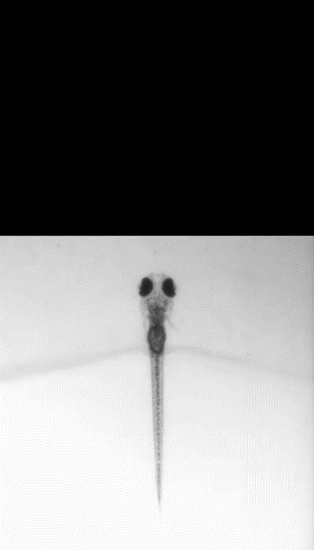
Prey capture in restrained animals
Semmelhack et al., 2019; Bianco et al., 2011

Slide 8
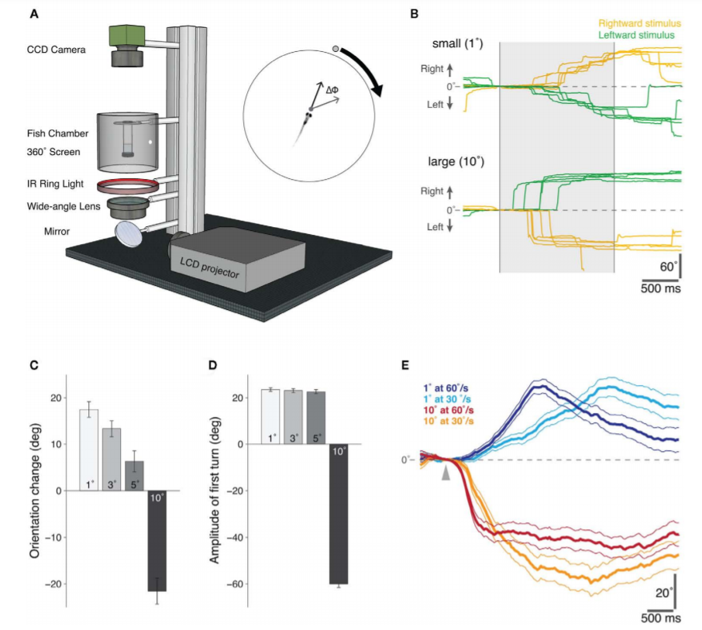
Size of stimulus alters behaviour
Small dots simulate prey; large dots are aversive
Bianco et al., 2011

Slide 9
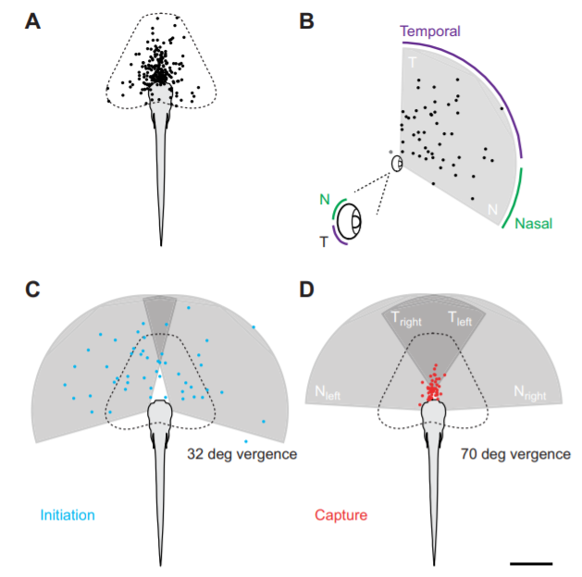
Convergence increases temporal field of retina
Patterson et al., 2013

Slide 10
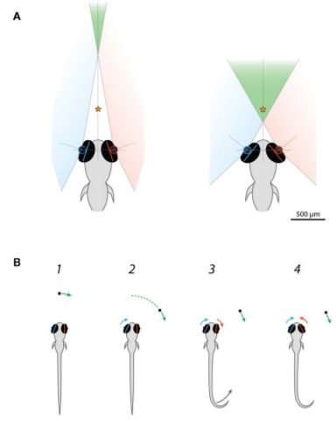
Eye convergence increases binocular vision
Convergence is not used to direct the gaze
at the prey, but rather to keep the stimulus
in binocular vision whilst hunting
Bianco et al., 2011

Slide 11
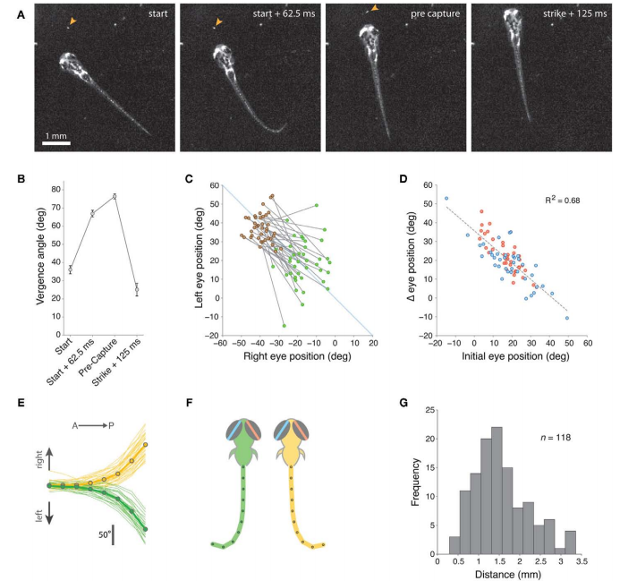
Detailed investigation of eye convergence
Convergence allows larvae to catch paramecia at a
greater number of angles
Bianco et al., 2011

Slide 12
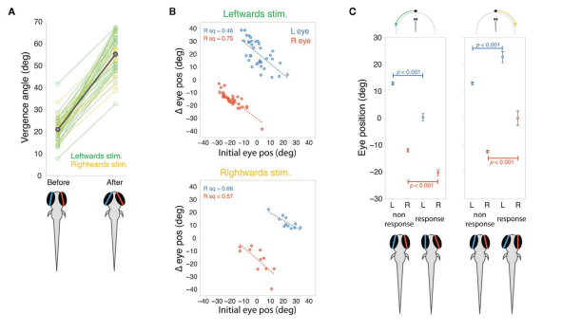
Initial position of eye biases prey capture
Bianco et al., 2011

Slide 13
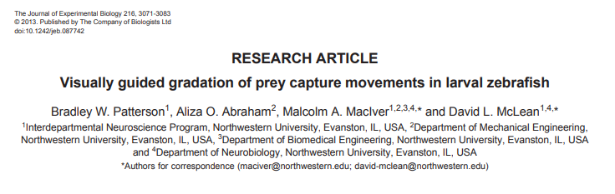
Fine analysis of movements involved in hunting
Video analysis can be used to understand the movements used in a complex behaviour
First step before characterising a neural circuit

Slide 14
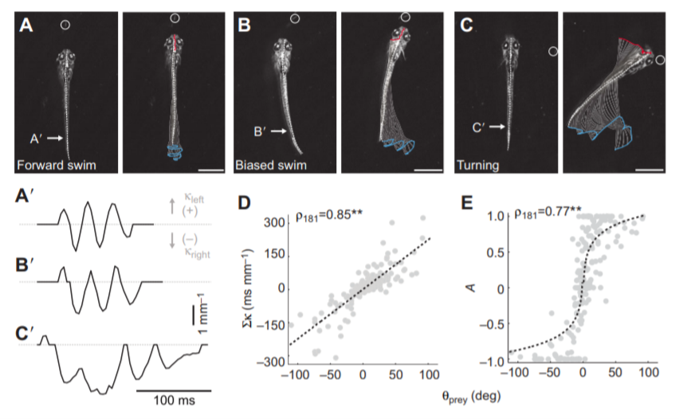
Prey capture involves different swim movements
Forward swims, targeted biased swims and turns
Patterson et al., 2013
Notes:
What are D and E here? Check

Slide 15
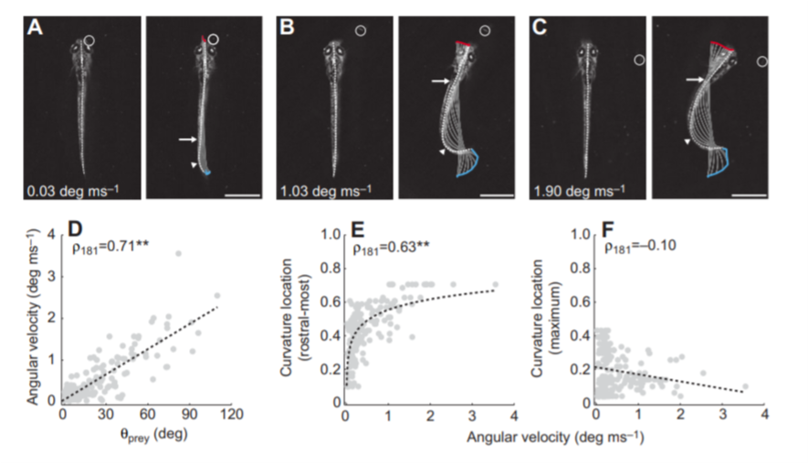
Orientation of larva towards prey
J-turn
Patterson et al., 2013

Slide 16
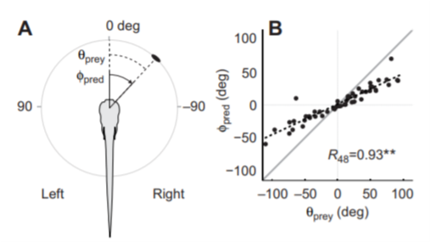
J-turn towards prey scales with position of target
Larger J-turn needed when prey are further away from centre of head
Patterson et al., 2013

Slide 17
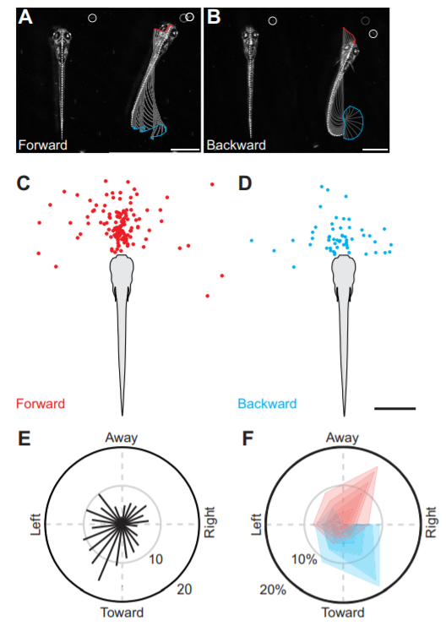
Larvae can also swim backwards to capture prey
Patterson et al., 2013

Slide 18
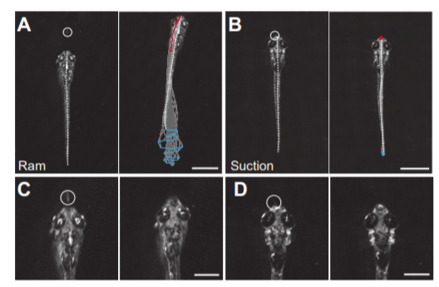
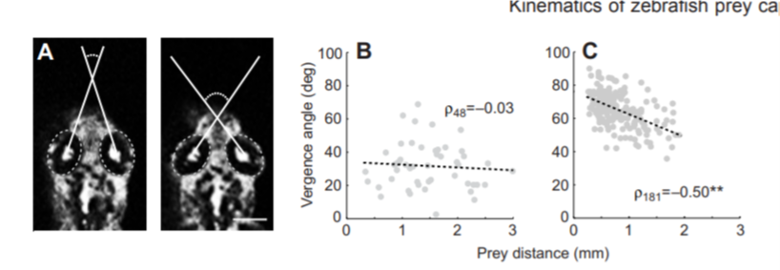
Different capture strategies are used
After
Before
After
Convergence of eyes – helps focus on prey
Patterson et al., 2013

Slide 19
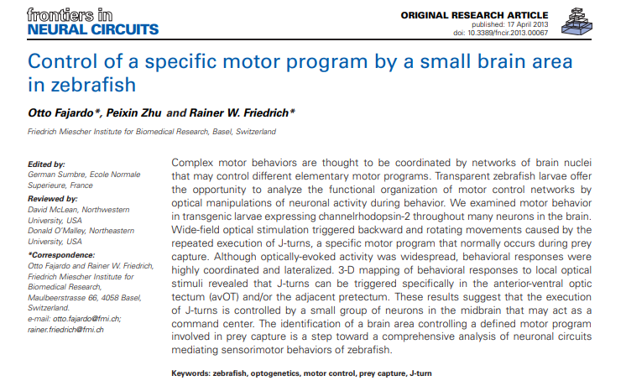
Optogenetic tools can dissect control of behaviour
Optogenetic drivers can activate brain areas and link them to behaviour

Slide 20
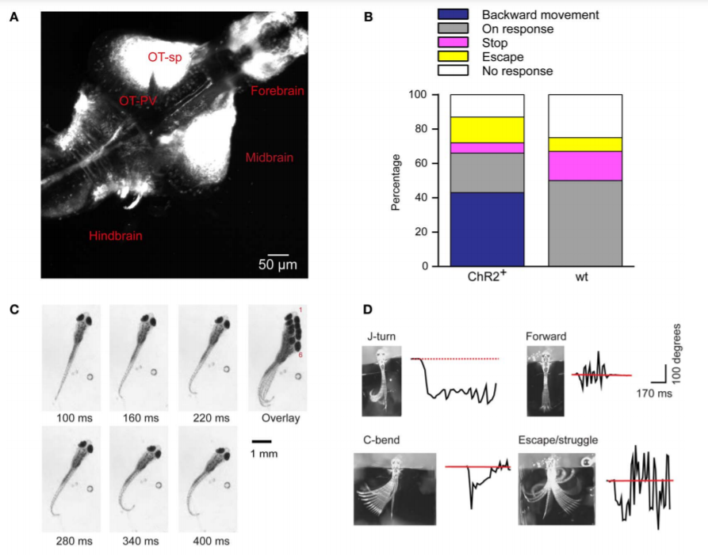
Light-driven behaviour in HuC:ChR2YFP line
Optic tectum of freely swimming fish stimulated with a blue light
Fajardo et al., 2013
Notes:
HuC expressed in all neurons

Slide 21
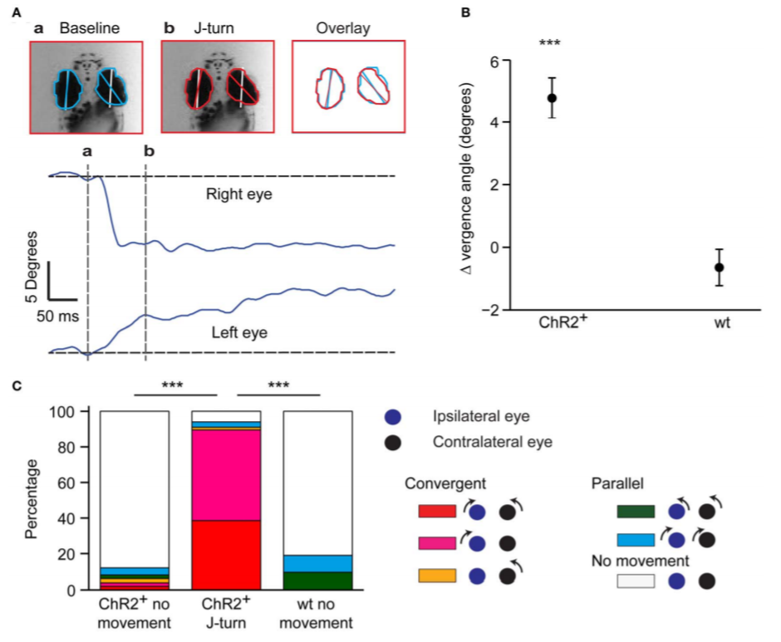
Eye convergence also triggered by optical stimulation
Fajardo et al., 2013

Slide 22
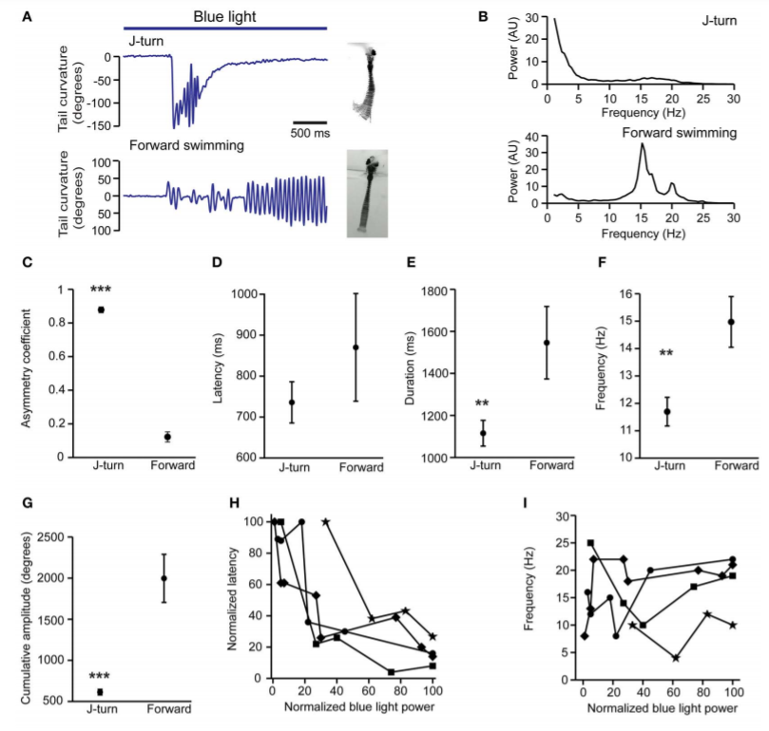
In-depth analysis of swim types upon stimulation
Fajardo et al., 2013
Notes:
Reread this one

Slide 23
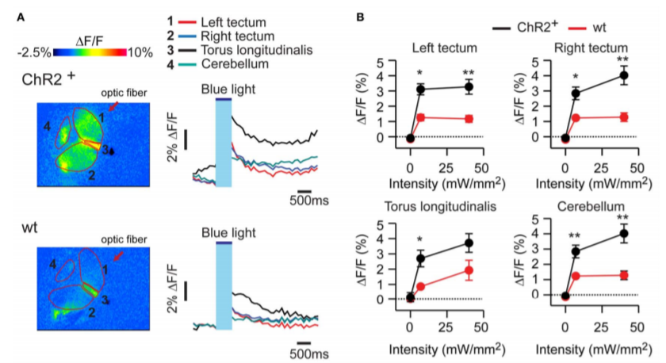
Neural activity in response to optogenetic stimulation
Fajardo et al., 2013

Slide 24
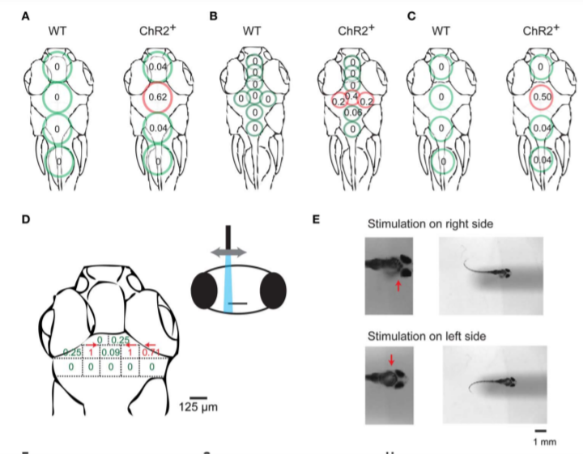
Mapping of J turns by local optical stimulation
Fajardo et al., 2013

Slide 25
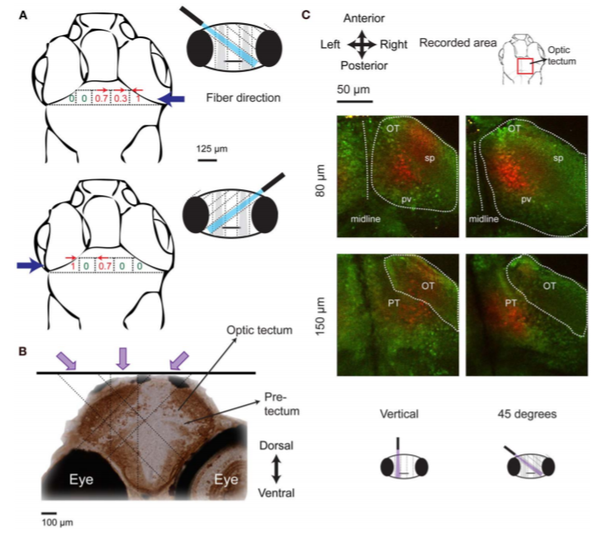
3D identification of brain area controlling J turns
Identifies the anterior ventral optic tectum (avOT)
Fajardo et al., 2013

Slide 26
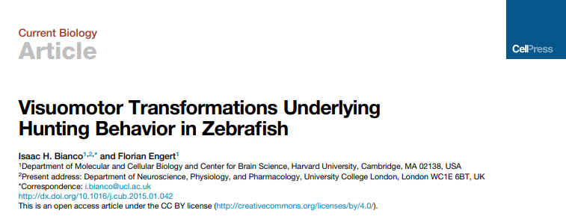
Which areas of the optic tectum respond to prey?
Finer dissection of tectal areas that are important for prey capture

Slide 27
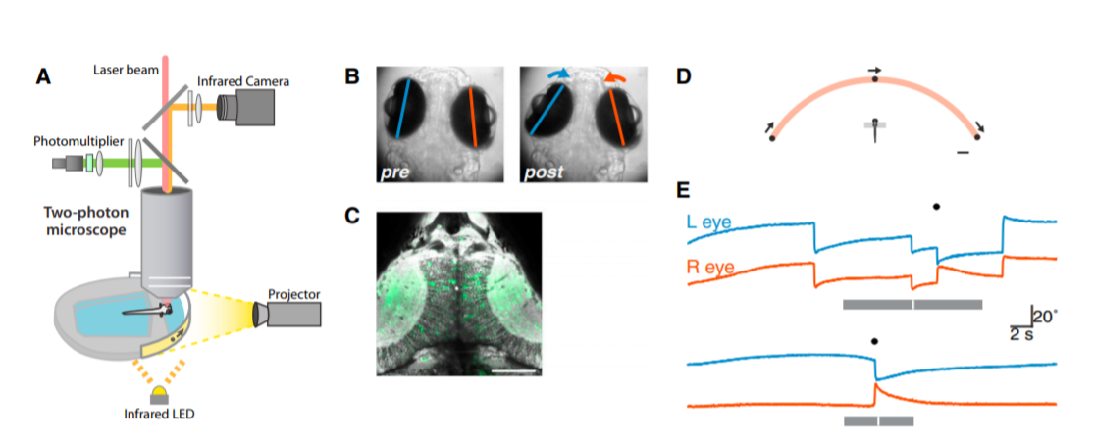
Calcium imaging of the optic tectum during prey capture
Bianco and Engert, 2015

Slide 28
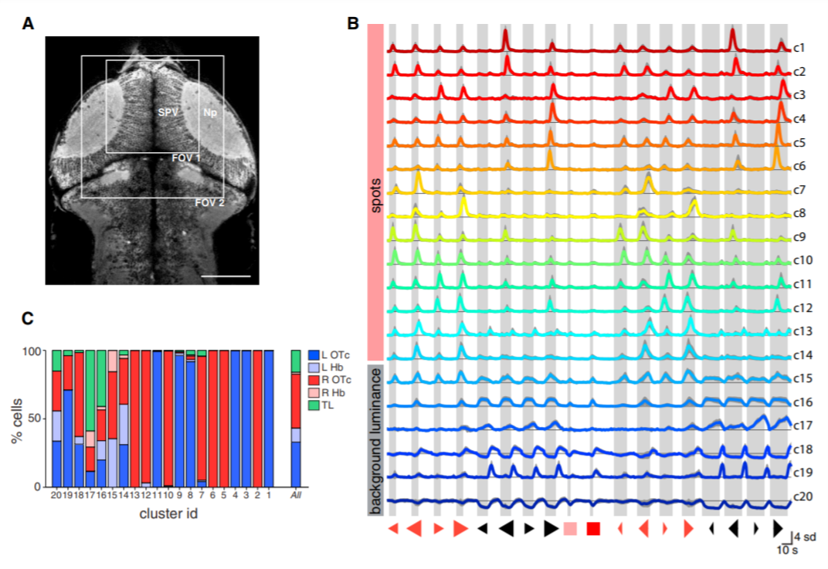
Identification of neural clusters that respond to hunting stimuli
Bianco and Engert, 2015
Notes:
Triangles show movement left or right. Size shows size of stimulus. Thin / fat denotes speed

Slide 29
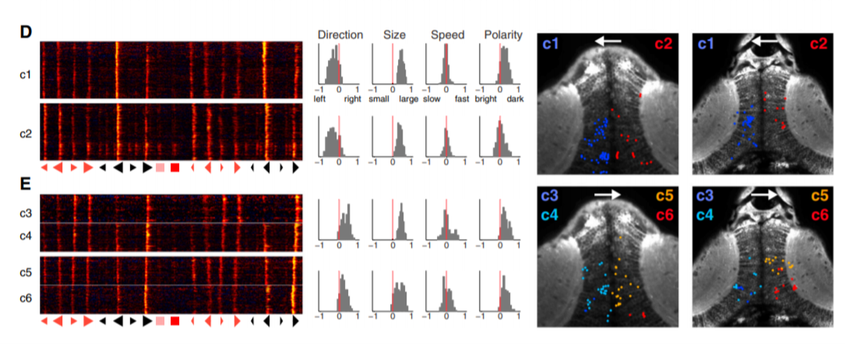
Clusters are tuned to multiple features of visual stimuli
Clusters 1 and 2 respond to large spots moving left
Clusters 3-6 respond to large spots moving right
Bianco and Engert, 2015

Slide 30
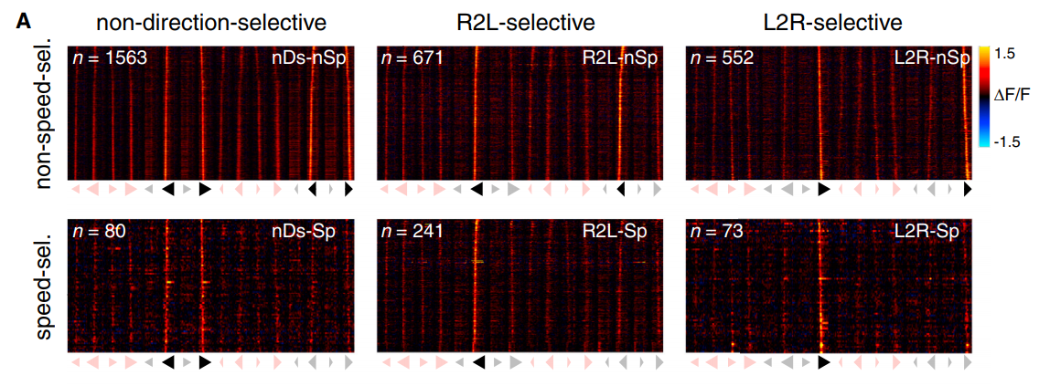
Clusters are tuned to different stimulus features
Visual response vectors (VRVs) of clusters in response to different stimuli
Non-linear Mixed Selectivity neurons in caudal Optic Tectum (OTc)
Act as groups of neurons called assemblies
Bianco and Engert, 2015

Slide 31
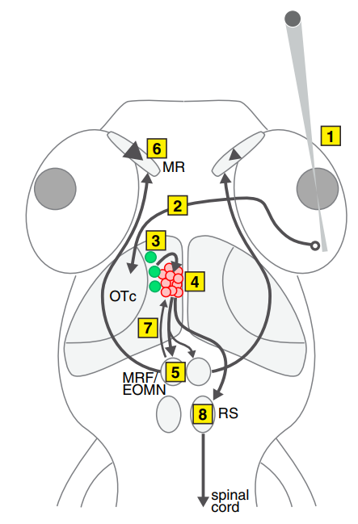
Neural circuit that responds to prey
We can integrate this information with the spinal cord
circuitry that controls escape responses: Mauthner neuron
Bianco and Engert, 2015

Slide 32
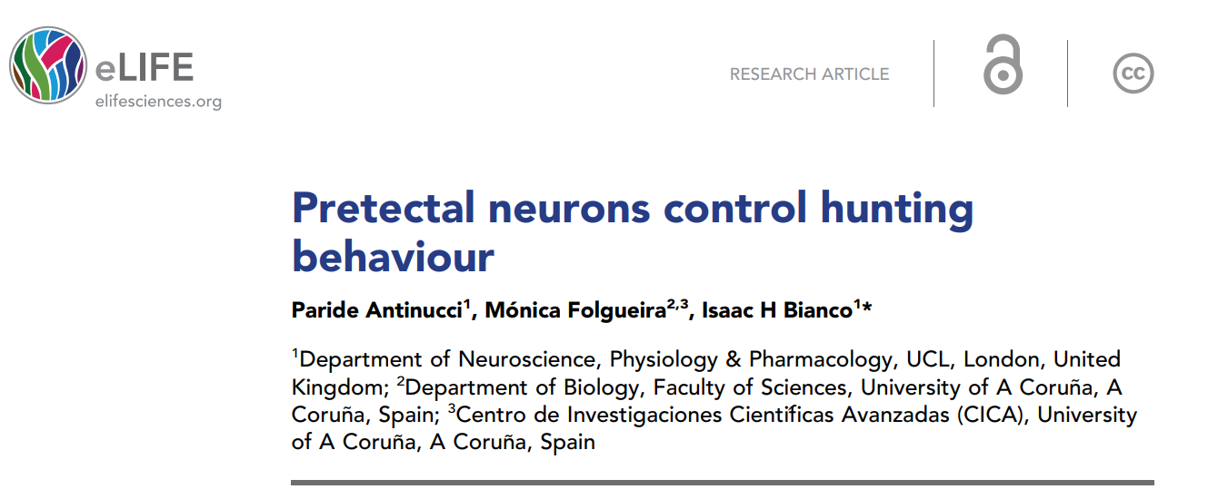
How is prey capture initiated?
Imaging the Optic Tectum allows neurons that respond to visual prey stimuli to be identified
But which neurons are needed to release or initiate hunting behaviour?

Slide 33
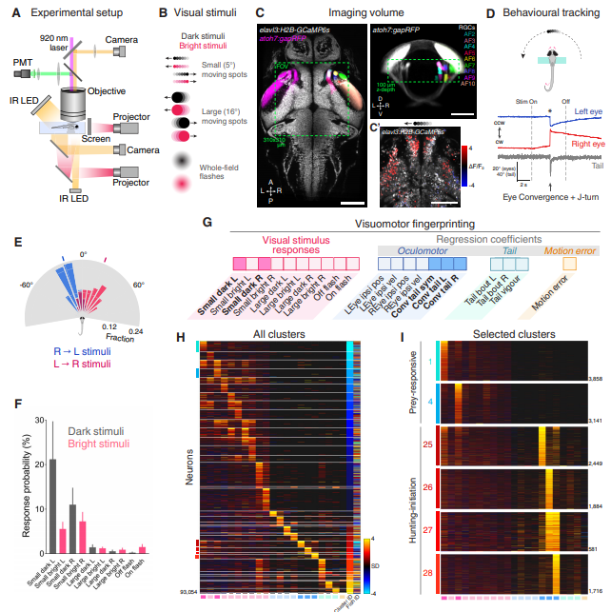
Image tectal neuropil using elavl3 and atoh7
Some clusters respond to visual stimulation
Some are activated later, when hunting is
initiated
Antinucci et al., 2019

Slide 34
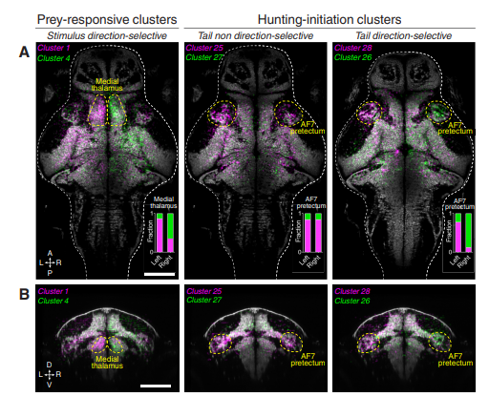
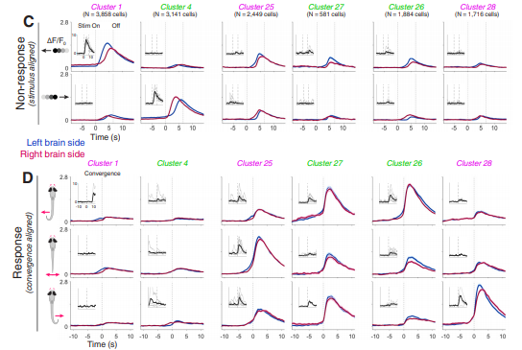
Four clusters identified in AF7 of pretectum
Cluster 1: Leftward prey movement
Cluster 4: Rightward prey movement Cluster 25: Leftward turn of tail
Cluster 27: Rightward turn of tail
Antinucci et al., 2019

Slide 35
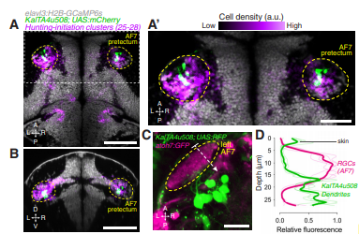
AF7 pretectal neurons labelled by Tg(KalTA4u508)
KalTA7u508 is an enhancer trap line expressed in AF7-pretectal region, as well as midbrain,
hindbrain, sensory ganglia and spinal cord (clusters 25-28)
A subset of KalTA4u508 neurons extend axons to terminals of retinal ganglion cells
Antinucci et al., 2019

Slide 36
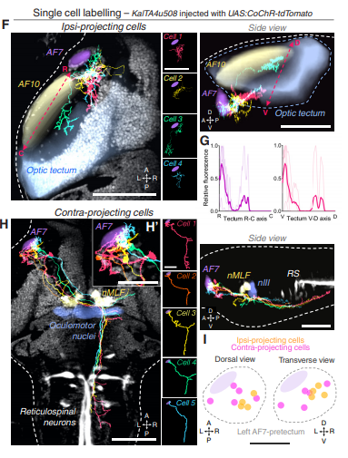
Stochastic labelling of single pretectal neurons
Inject a construct containing a fluorescent reporter at the single
cell stage – should only label a few cells in a stochastic manner
Different classes of neurons:
Some project ipsilaterally, some contralaterally, some descend
to midbrain and hindbrain
Antinucci et al., 2019

Slide 37
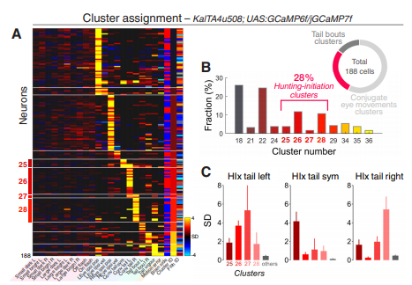
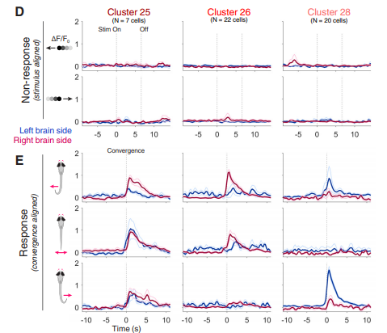
KalTA4u508+ve AF7 neurons are active when hunting is initiated
Focus on clusters 25-28
Antinucci et al., 2019

Slide 38
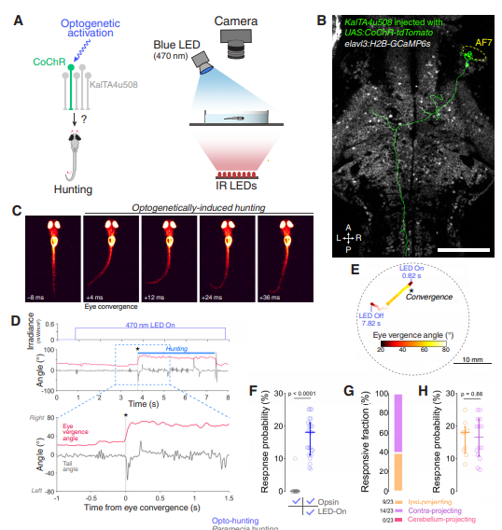
Optogenetic stimulation of AF7 neurons stimulates hunting
Stimulation of a single neuron can intiate
Hhunting – command neuron?
Both ipsi- and contralateral projecting
neurons can trigger hunting
Antinucci et al., 2019

Slide 39
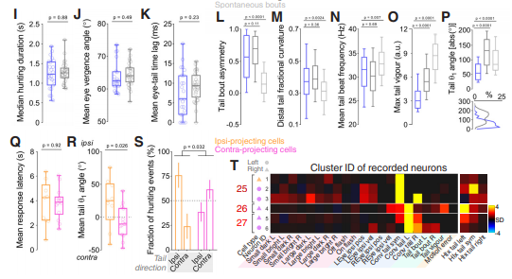
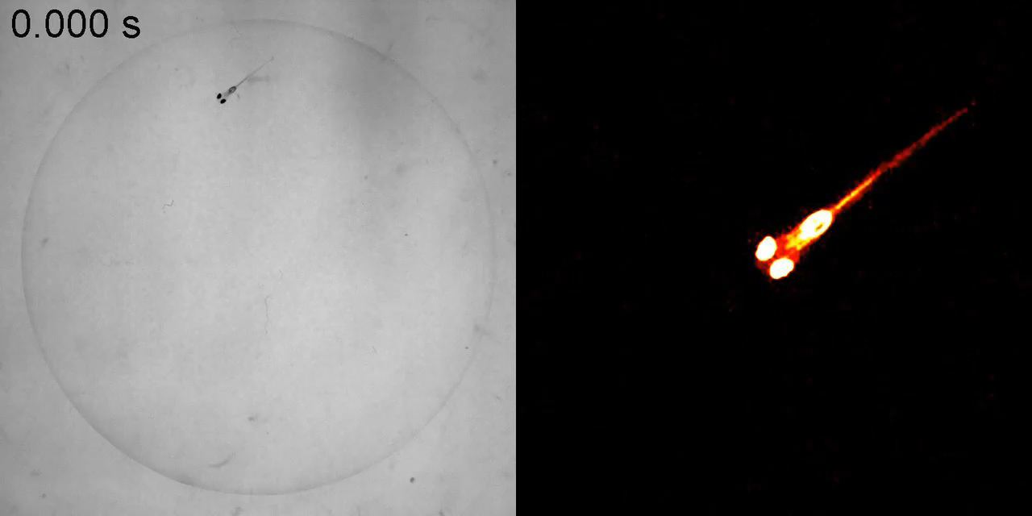
Natural and stimulated hunting are similar
Free swimming larvae hunting paramecia in a Petri dish
Antinucci et al., 2019

Slide 40
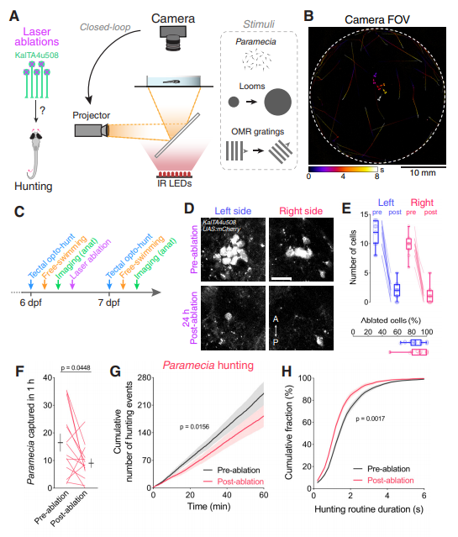
Ablation of pretectal neurons decreases hunting
Ablation of AF7 neurons –
as many as possible
Antinucci et al., 2019

Slide 41
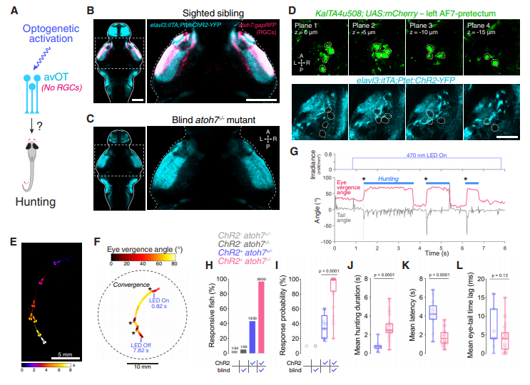
Tectal stimulation also triggers hunting in blind fish!
Lakritz / atoh7-/- mutants lack RGC and so are blind: hunting more robust in absence of vision
Antinucci et al., 2019
Notes:
This suggests that vision interferes with stimulation of hunting

Slide 42
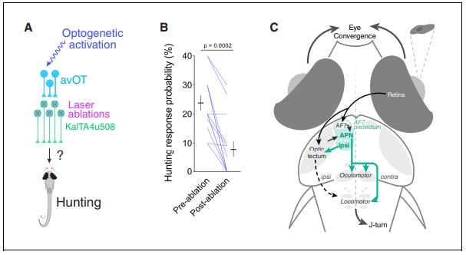
Summary: neural circuit that controls prey capture
Antinucci et al., 2019

